Slide 1

Automata Seluler 2
Cellular Automata
Sebuah cara sederhana menyatakan cara kerja dunia dan algoritma hanya dalam papan kotak

Slide 2
Papan kotak 2
Papan kotak yang memiliki rule penulisan kotak
Melihat papan kotak sebagai penulisan pada pita memori
Saatnya mencoba sendiri bermain-main dengan papan kotak

Slide 3
Papan Kotak 2 (papan sel)
Rule 1:
X
X
 | Y
Rule 2:
Y
Y
Z | X
Rule 3:
 | Z
 | Z
X

Slide 4
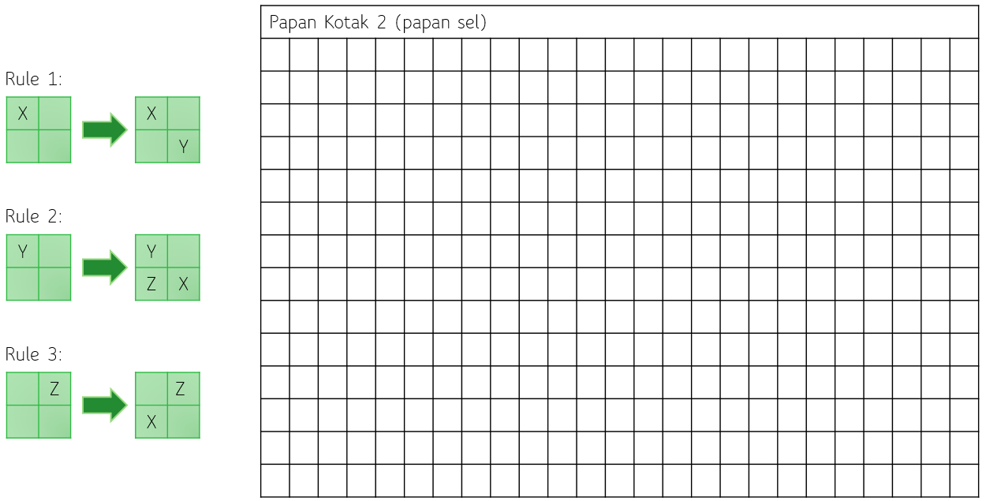
Jalankan atau Eksekusi Rule 1, 2 dan 3 pada papan kotak
Contoh Mesin Abstrak, mesin yang bisa mewakili cara kerja seluruh mesin di dunia di atas kertas atau di dalam simulasi komputer.
Anda bisa membuat banyak rule, terserah anda.
Ini adalah contoh bagaimana automata seluler bekerja.
Rule 1, rule 2 dan rule 3 adalah instruksi-instruksi automata.
Setiap kotak papan kecil adalah sebuah sel.
Itulah sebabnya dikatakan automata seluler
Automata seluler adalah mesin abstrak. Dikatakan abstrak karena dia dapat memodelkan semua mesin di dunia ini. Mesin apa saja.
Artinya bahwa sebarang mesin di dunia ini dapat dinyatakan ke dalam kumpulan rule dan papan kotak.

Slide 5
Contoh kerja mesin:
 |  |  |  |  |  |  |  |  |  |  | X
Rule 1:
X
X
 | Y
Mulai
Rule 2:
Y
Y
Z | X
Rule 3:
 | Z
 | Z
X

Slide 6
Eksekusi rule 1
 |  |  |  |  |  |  |  |  |  |  | X
 |  |  |  |  |  |  |  |  |  |  |  | Y
Rule 1:
X
X
 | Y
Rule 2:
Y
Y
Z | X
Rule 3:
 | Z
 | Z
X

Slide 7
Eksekusi rule 2
 |  |  |  |  |  |  |  |  |  |  | X
 |  |  |  |  |  |  |  |  |  |  |  | Y
 |  |  |  |  |  |  |  |  |  |  |  | Z | X
Rule 1:
X
X
 | Y
Rule 2:
Y
Y
Z | X
Rule 3:
 | Z
 | Z
X

Slide 8
Eksekusi rule 3 dan rule 1
 |  |  |  |  |  |  |  |  |  |  | X
 |  |  |  |  |  |  |  |  |  |  |  | Y
 |  |  |  |  |  |  |  |  |  |  |  | Z | X
 |  |  |  |  |  |  |  |  |  |  | X |  |  | Y
Rule 1:
X
X
 | Y
Rule 2:
Y
Y
Z | X
Rule 3:
 | Z
 | Z
X

Slide 9
Eksekusi rule 1 dan rule 2
 |  |  |  |  |  |  |  |  |  |  | X
 |  |  |  |  |  |  |  |  |  |  |  | Y
 |  |  |  |  |  |  |  |  |  |  |  | Z | X
 |  |  |  |  |  |  |  |  |  |  | X |  |  | Y
 |  |  |  |  |  |  |  |  |  |  |  | Y |  | Z | X
Rule 1:
X
X
 | Y
Rule 2:
Y
Y
Z | X
Rule 3:
 | Z
 | Z
X

Slide 10
Eksekusi rule 2 dan rule 3 dan rule 1
 |  |  |  |  |  |  |  |  |  |  | X
 |  |  |  |  |  |  |  |  |  |  |  | Y
 |  |  |  |  |  |  |  |  |  |  |  | Z | X
 |  |  |  |  |  |  |  |  |  |  | X |  |  | Y
 |  |  |  |  |  |  |  |  |  |  |  | Y |  | Z | X
 |  |  |  |  |  |  |  |  |  |  |  | Z | X |  |  | Y
Rule 1:
X
X
 | Y
Rule 2:
Y
Y
Z | X
Rule 3:
 | Z
 | Z
X

Slide 11
Eksekusi rule 3 dan rule 1 dan rule 2
 |  |  |  |  |  |  |  |  |  |  | X
 |  |  |  |  |  |  |  |  |  |  |  | Y
 |  |  |  |  |  |  |  |  |  |  |  | Z | X
 |  |  |  |  |  |  |  |  |  |  | X |  |  | Y
 |  |  |  |  |  |  |  |  |  |  |  | Y |  | Z | X
 |  |  |  |  |  |  |  |  |  |  |  | Z | X |  |  | Y
 |  |  |  |  |  |  |  |  |  |  | X |  |  | Y |  | Z | X
Rule 1:
X
X
 | Y
Rule 2:
Y
Y
Z | X
Rule 3:
 | Z
 | Z
X

Slide 12
Eksekusi rule 1 lalu rule 2 lalu rule 3 kemudian rule 1 lagi
 |  |  |  |  |  |  |  |  |  |  | X
 |  |  |  |  |  |  |  |  |  |  |  | Y
 |  |  |  |  |  |  |  |  |  |  |  | Z | X
 |  |  |  |  |  |  |  |  |  |  | X |  |  | Y
 |  |  |  |  |  |  |  |  |  |  |  | Y |  | Z | X
 |  |  |  |  |  |  |  |  |  |  |  | Z | X |  |  | Y
 |  |  |  |  |  |  |  |  |  |  | X |  |  | Y |  | Z | X
 |  |  |  |  |  |  |  |  |  |  |  | Y |  | Z | X |  |  | Y
Rule 1:
X
X
 | Y
Rule 2:
Y
Y
Z | X
Rule 3:
 | Z
 | Z
X

Slide 13
Eksekusi rule 2 lalu rule 3 lalu rule 1 kemudian rule 2 lagi
 |  |  |  |  |  |  |  |  |  |  | X
 |  |  |  |  |  |  |  |  |  |  |  | Y
 |  |  |  |  |  |  |  |  |  |  |  | Z | X
 |  |  |  |  |  |  |  |  |  |  | X |  |  | Y
 |  |  |  |  |  |  |  |  |  |  |  | Y |  | Z | X
 |  |  |  |  |  |  |  |  |  |  |  | Z | X |  |  | Y
 |  |  |  |  |  |  |  |  |  |  | X |  |  | Y |  | Z | X
 |  |  |  |  |  |  |  |  |  |  |  | Y |  | Z | X |  |  | Y
 |  |  |  |  |  |  |  |  |  |  |  | Z | X |  |  | Y |  | Z | X
Rule 1:
X
X
 | Y
Rule 2:
Y
Y
Z | X
Rule 3:
 | Z
 | Z
X

Slide 14
Eksekusi rule 3 lalu rule 1 lalu rule 2 kemudian rule 3 lagi dan rule 1
 |  |  |  |  |  |  |  |  |  |  | X
 |  |  |  |  |  |  |  |  |  |  |  | Y
 |  |  |  |  |  |  |  |  |  |  |  | Z | X
 |  |  |  |  |  |  |  |  |  |  | X |  |  | Y
 |  |  |  |  |  |  |  |  |  |  |  | Y |  | Z | X
 |  |  |  |  |  |  |  |  |  |  |  | Z | X |  |  | Y
 |  |  |  |  |  |  |  |  |  |  | X |  |  | Y |  | Z | X
 |  |  |  |  |  |  |  |  |  |  |  | Y |  | Z | X |  |  | Y
 |  |  |  |  |  |  |  |  |  |  |  | Z | X |  |  | Y |  | Z | X
 |  |  |  |  |  |  |  |  |  |  | X |  |  | Y |  | Z | X |  |  | Y
Rule 1:
X
X
 | Y
Rule 2:
Y
Y
Z | X
Rule 3:
 | Z
 | Z
X

Slide 15
Eksekusi rule 3 lalu rule 1 lalu rule 2 kemudian rule 3 lagi dan rule 1
 |  |  |  |  |  |  |  |  |  |  | X
 |  |  |  |  |  |  |  |  |  |  |  | Y
 |  |  |  |  |  |  |  |  |  |  |  | Z | X
 |  |  |  |  |  |  |  |  |  |  | X |  |  | Y
 |  |  |  |  |  |  |  |  |  |  |  | Y |  | Z | X
 |  |  |  |  |  |  |  |  |  |  |  | Z | X |  |  | Y
 |  |  |  |  |  |  |  |  |  |  | X |  |  | Y |  | Z | X
 |  |  |  |  |  |  |  |  |  |  |  | Y |  | Z | X |  |  | Y
 |  |  |  |  |  |  |  |  |  |  |  | Z | X |  |  | Y |  | Z | X
 |  |  |  |  |  |  |  |  |  |  | X |  |  | Y |  | Z | X |  |  | Y
 |  |  |  |  |  |  |  |  |  |  |  | Y |  | Z | X |  |  | Y |  | Z | X
Rule 1:
X
X
 | Y
Rule 2:
Y
Y
Z | X
Rule 3:
 | Z
 | Z
X

Slide 16
Eksekusi rule 2 lalu rule 3 lalu rule 1 kemudian rule 2 lagi dan rule 3 dan rule 1
 |  |  |  |  |  |  |  |  |  |  | X
 |  |  |  |  |  |  |  |  |  |  |  | Y
 |  |  |  |  |  |  |  |  |  |  |  | Z | X
 |  |  |  |  |  |  |  |  |  |  | X |  |  | Y
 |  |  |  |  |  |  |  |  |  |  |  | Y |  | Z | X
 |  |  |  |  |  |  |  |  |  |  |  | Z | X |  |  | Y
 |  |  |  |  |  |  |  |  |  |  | X |  |  | Y |  | Z | X
 |  |  |  |  |  |  |  |  |  |  |  | Y |  | Z | X |  |  | Y
 |  |  |  |  |  |  |  |  |  |  |  | Z | X |  |  | Y |  | Z | X
 |  |  |  |  |  |  |  |  |  |  | X |  |  | Y |  | Z | X |  |  | Y
 |  |  |  |  |  |  |  |  |  |  |  | Y |  | Z | X |  |  | Y |  | Z | X
 |  |  |  |  |  |  |  |  |  |  |  | Z | X |  |  | Y |  | Z | X |  |  | Y
Rule 1:
X
X
 | Y
Rule 2:
Y
Y
Z | X
Rule 3:
 | Z
 | Z
X

Slide 17
Eksekusi rule 3, rule 1, rule 2, rule 3, rule 1, rule 2
 |  |  |  |  |  |  |  |  |  |  | X
 |  |  |  |  |  |  |  |  |  |  |  | Y
 |  |  |  |  |  |  |  |  |  |  |  | Z | X
 |  |  |  |  |  |  |  |  |  |  | X |  |  | Y
 |  |  |  |  |  |  |  |  |  |  |  | Y |  | Z | X
 |  |  |  |  |  |  |  |  |  |  |  | Z | X |  |  | Y
 |  |  |  |  |  |  |  |  |  |  | X |  |  | Y |  | Z | X
 |  |  |  |  |  |  |  |  |  |  |  | Y |  | Z | X |  |  | Y
 |  |  |  |  |  |  |  |  |  |  |  | Z | X |  |  | Y |  | Z | X
 |  |  |  |  |  |  |  |  |  |  | X |  |  | Y |  | Z | X |  |  | Y
 |  |  |  |  |  |  |  |  |  |  |  | Y |  | Z | X |  |  | Y |  | Z | X
 |  |  |  |  |  |  |  |  |  |  |  | Z | X |  |  | Y |  | Z | X |  |  | Y
 |  |  |  |  |  |  |  |  |  |  | X |  |  | Y |  | Z | X |  |  | Y |  | Z | X
Rule 1:
X
X
 | Y
Rule 2:
Y
Y
Z | X
Rule 3:
 | Z
 | Z
X

Slide 18
Eksekusi rule 1, rule 2, rule 3, rule 1, rule 2, rule 3, rule 1
 |  |  |  |  |  |  |  |  |  |  | X
 |  |  |  |  |  |  |  |  |  |  |  | Y
 |  |  |  |  |  |  |  |  |  |  |  | Z | X
 |  |  |  |  |  |  |  |  |  |  | X |  |  | Y
 |  |  |  |  |  |  |  |  |  |  |  | Y |  | Z | X
 |  |  |  |  |  |  |  |  |  |  |  | Z | X |  |  | Y
 |  |  |  |  |  |  |  |  |  |  | X |  |  | Y |  | Z | X
 |  |  |  |  |  |  |  |  |  |  |  | Y |  | Z | X |  |  | Y
 |  |  |  |  |  |  |  |  |  |  |  | Z | X |  |  | Y |  | Z | X
 |  |  |  |  |  |  |  |  |  |  | X |  |  | Y |  | Z | X |  |  | Y
 |  |  |  |  |  |  |  |  |  |  |  | Y |  | Z | X |  |  | Y |  | Z | X
 |  |  |  |  |  |  |  |  |  |  |  | Z | X |  |  | Y |  | Z | X |  |  | Y
 |  |  |  |  |  |  |  |  |  |  | X |  |  | Y |  | Z | X |  |  | Y |  | Z | X
 |  |  |  |  |  |  |  |  |  |  |  | Y |  | Z | X |  |  | Y |  | Z | X |  |  | Y
Rule 1:
X
X
 | Y
Hasil eksekusi mesin
Rule 2:
Y
Y
Z | X
Rule 3:
 | Z
 | Z
X

Slide 19
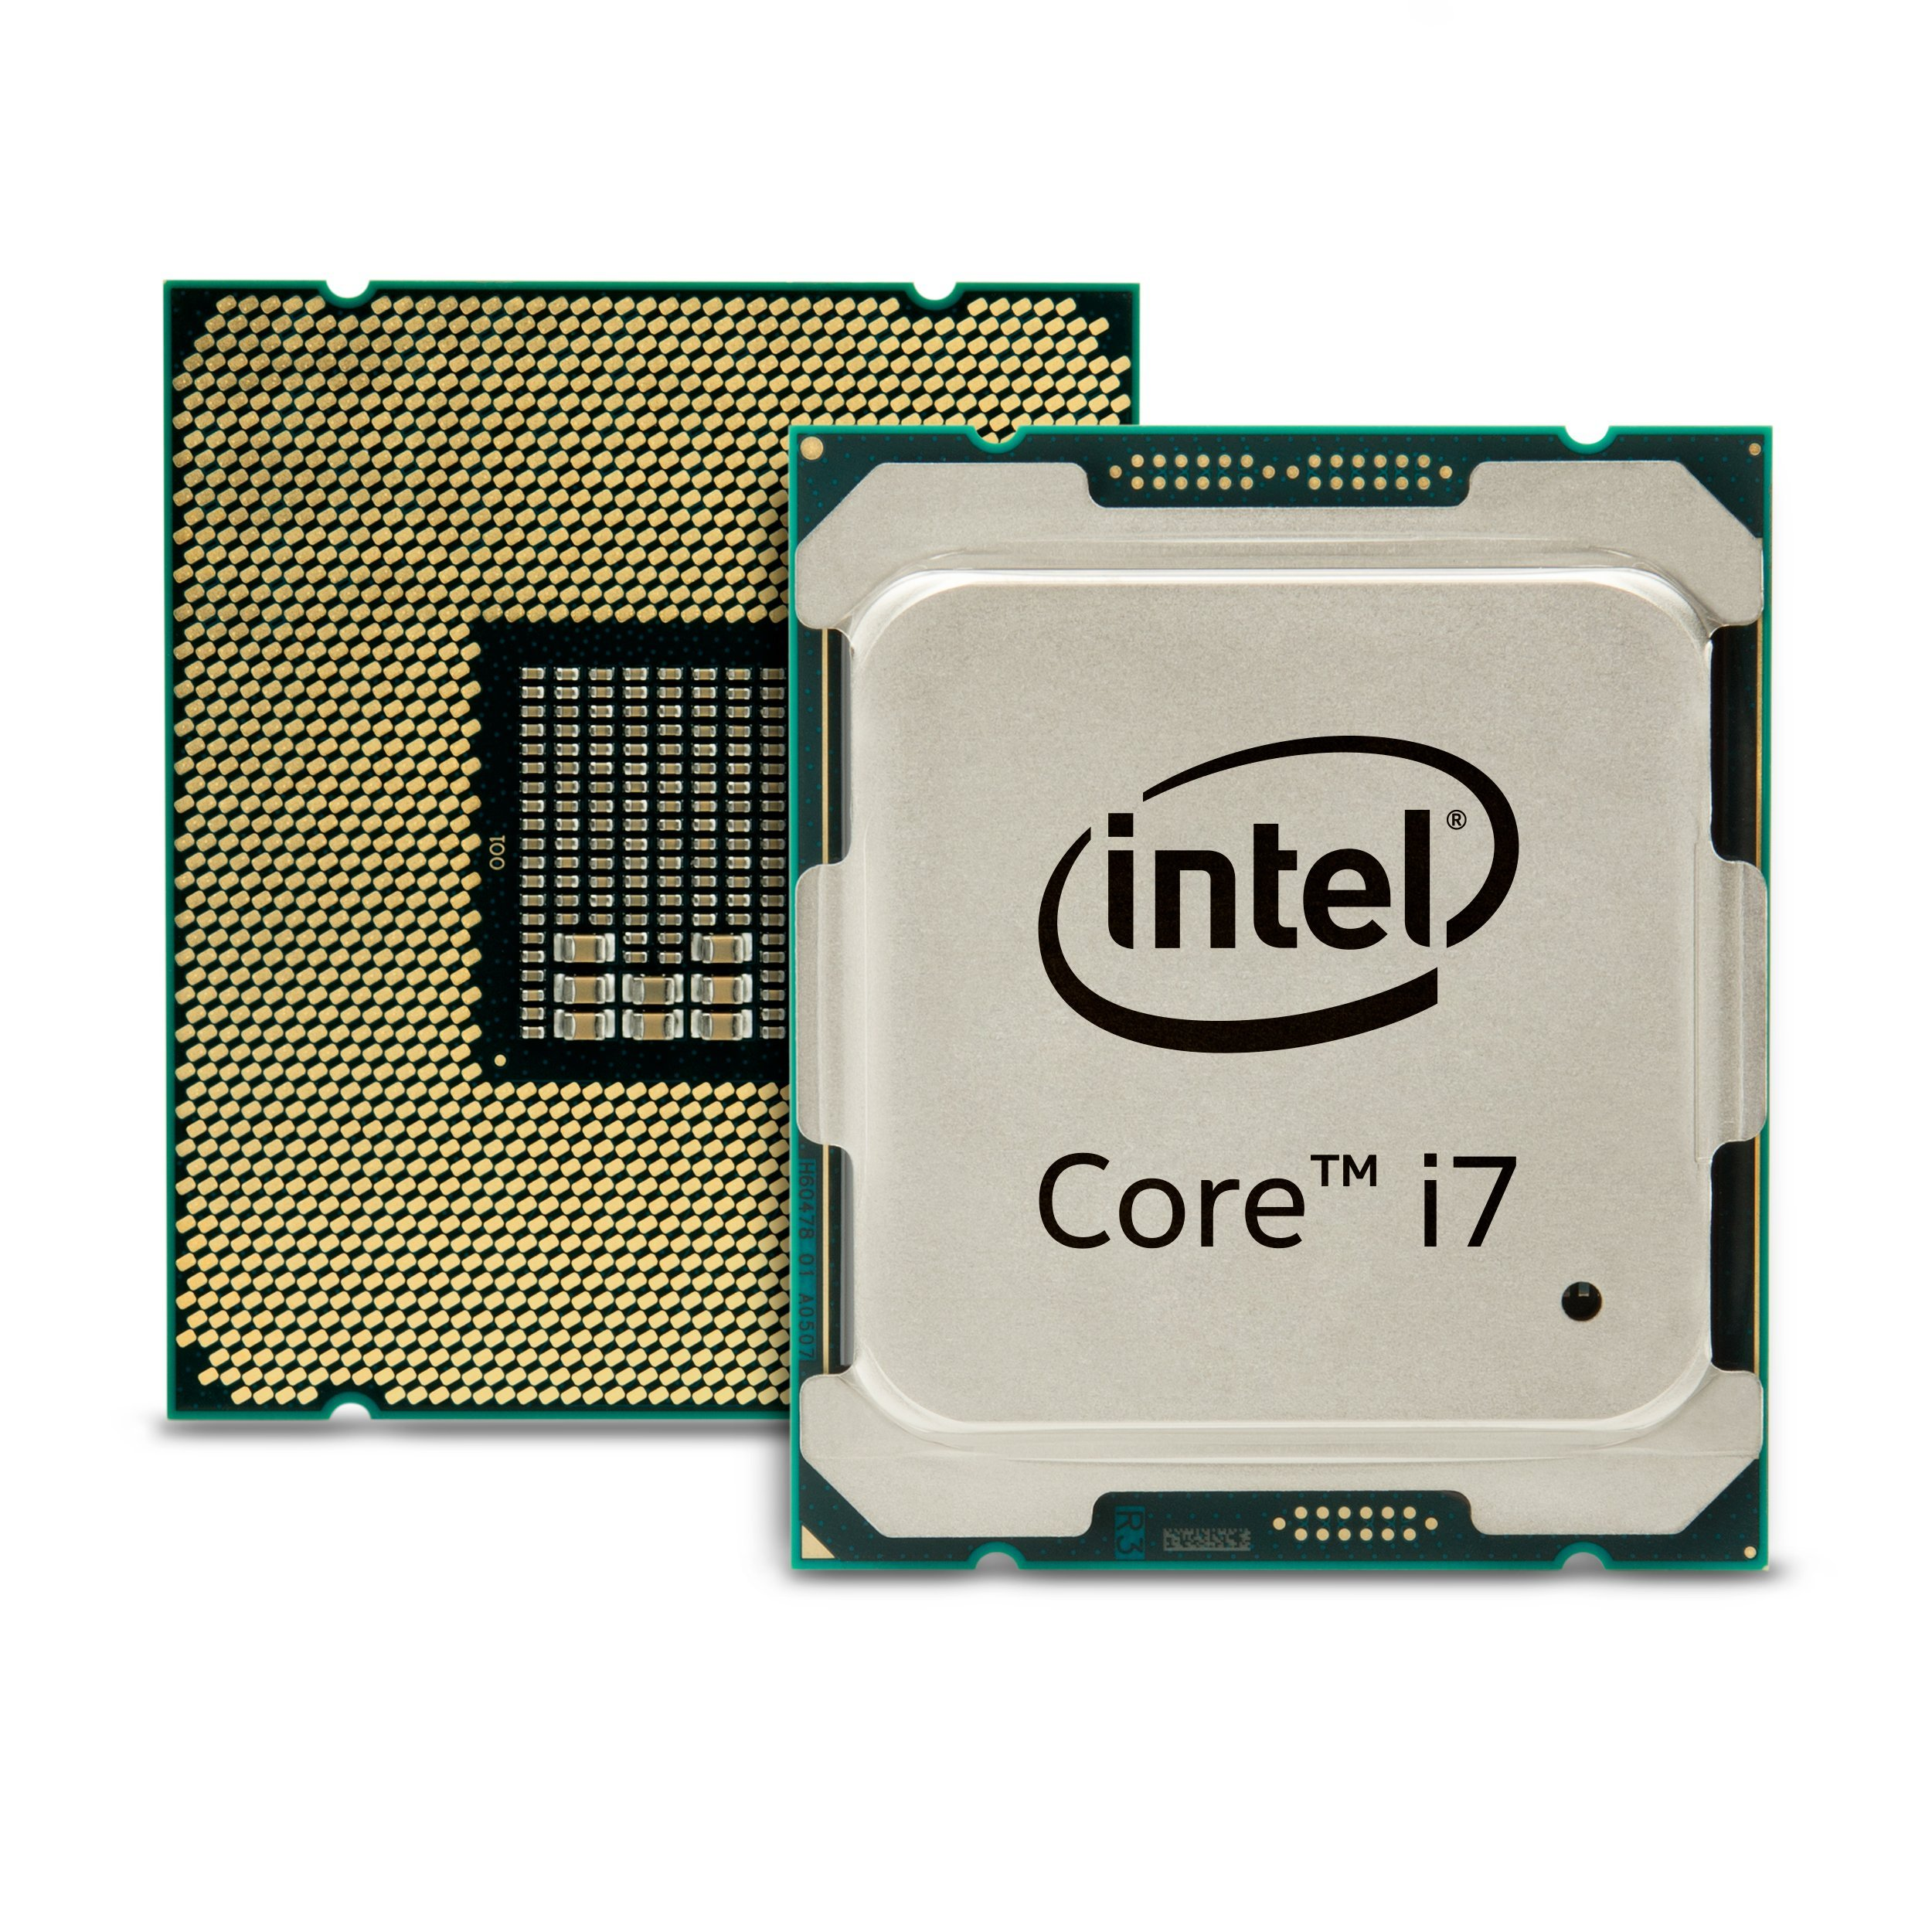
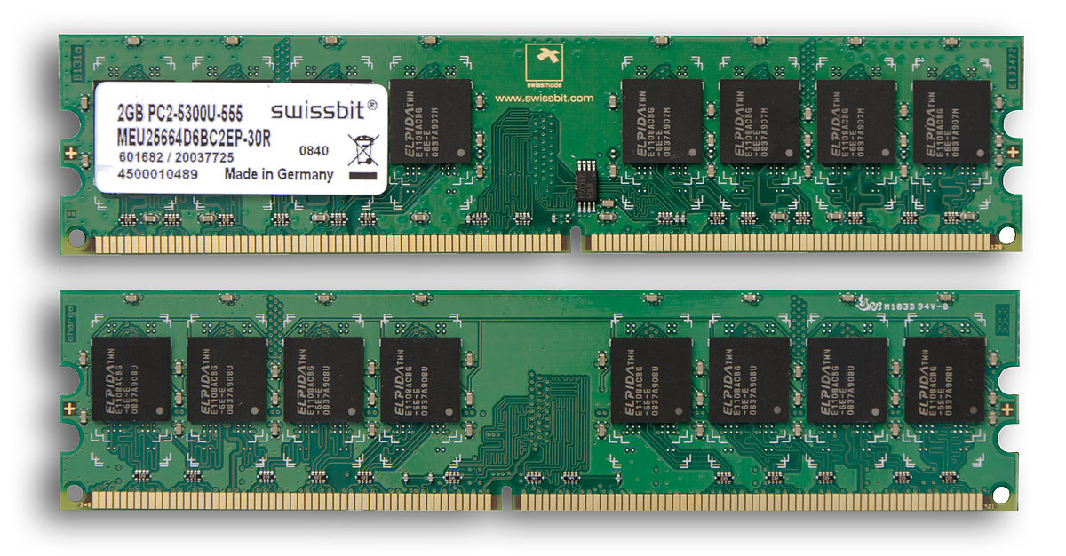
Simulasi prosesor menggunakan automata seluler, yaitu bagaimana menggunakan automata seluler sebagai prosesor yang mengeksekusi program atau Algoritma
This Photo by Unknown Author is licensed under CC BY-SA-NC
This Photo by Unknown Author is licensed under CC BY-SA

Slide 20
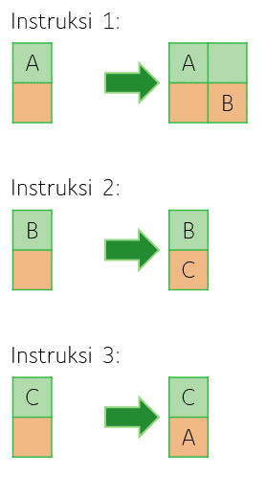
AAB
CCA
DDA
Prosesor
Loading kode program ke memori RAM
AAB CCA DDA
File program
Papan RAM (pita sel memori di dalam RAM, mode read/baca)
A | A | B |  | C | C | A |  | D | D | A
Eksekusi kode program di mulai pada titik masuk baca file
Papan RAM (pita sel memori di dalam RAM, mode tulis/write)
Register baca
Register tulis

Slide 21
Eksekusi kode program di mulai
Prosesor
Eksekusi
Papan RAM (pita sel memori di dalam RAM, mode read/baca)
A | A | B |  | C | C | A |  | D | D | A
Baca kode A, pindahkan ke register baca
Papan RAM (pita sel memori di dalam RAM, mode tulis/write)
 | B
Register baca
A
Tulis kode B ke memori, hasil dari register baca
Register tulis
 | B

Slide 22
Eksekusi kode program
Prosesor
Eksekusi
Papan RAM (pita sel memori di dalam RAM, mode read/baca)
A | A | B |  | C | C | A |  | D | D | A
Baca kode A berikut, pindahkan ke register baca
Papan RAM (pita sel memori di dalam RAM, mode tulis/write)
 | B | B
Register baca
A
Tulis kode B berikut ke memori, hasil dari register baca
Register tulis
 | B

Slide 23
Eksekusi kode program
Prosesor
Papan RAM (pita sel memori di dalam RAM, mode read/baca)
A | A | B |  | C | C | A |  | D | D | A
Eksekusi
Baca kode A berikut, pindahkan ke register baca
Papan RAM (pita sel memori di dalam RAM, mode tulis/write)
 | B | C
Register baca
B
Tulis kode C berikut ke memori menimpa posisi B sebelumnya, hasil dari register baca
Register tulis
C

Slide 24
Eksekusi kode program
Prosesor
Papan RAM (pita sel memori di dalam RAM, mode read/baca)
A | A | B |  | C | C | A |  | D | D | A
Baca kode A berikut, pindahkan ke register baca
Eksekusi
Papan RAM (pita sel memori di dalam RAM, mode tulis/write)
 | B | C |  | A
Register baca
C
Tulis kode A berikut ke memori, hasil dari register baca
Register tulis
A

Slide 25
Eksekusi kode program
Prosesor
Papan RAM (pita sel memori di dalam RAM, mode read/baca)
A | A | B |  | C | C | A |  | D | D | A
Baca kode A berikut, pindahkan ke register baca
Eksekusi
Papan RAM (pita sel memori di dalam RAM, mode tulis/write)
 | B | C |  | A | A
Register baca
C
Tulis kode A berikut ke memori, hasil dari register baca
Register tulis
A

Slide 26
Eksekusi kode program
Prosesor
Eksekusi
Papan RAM (pita sel memori di dalam RAM, mode read/baca)
A | A | B |  | C | C | A |  | D | D | A
Baca kode A berikut, pindahkan ke register baca
Papan RAM (pita sel memori di dalam RAM, mode tulis/write)
 | B | C |  | A | A |  | B
Register baca
A
Tulis kode B berikut ke memori, hasil dari register baca
Register tulis
 | B

Slide 27
Eksekusi kode program
Prosesor
Papan RAM (pita sel memori di dalam RAM, mode read/baca)
A | A | B |  | C | C | A |  | D | D | A
Baca kode D, pindahkan ke register baca
HALT
Papan RAM (pita sel memori di dalam RAM, mode tulis/write)
 | B | C |  | A | A |  | B
Register baca
D
Penulisan berhenti disini karena eksekusi berhenti/Halt
Register tulis
Eksekusi kode program behenti karena tidak ada instruksi yang bisa mengeksekusi kode D pada program di memori, ini menghasilkan pesan Error
HALT

Slide 28
Quis
X
X
 | Y
XXXXZ
XYZZZ
Eksekusi file berikut
Rule 2:
Y
Y
Z | X
Rule 3:
Menggunakan set instruksi prosesor berikut
 | Z
 | Z
X

